Slide 1
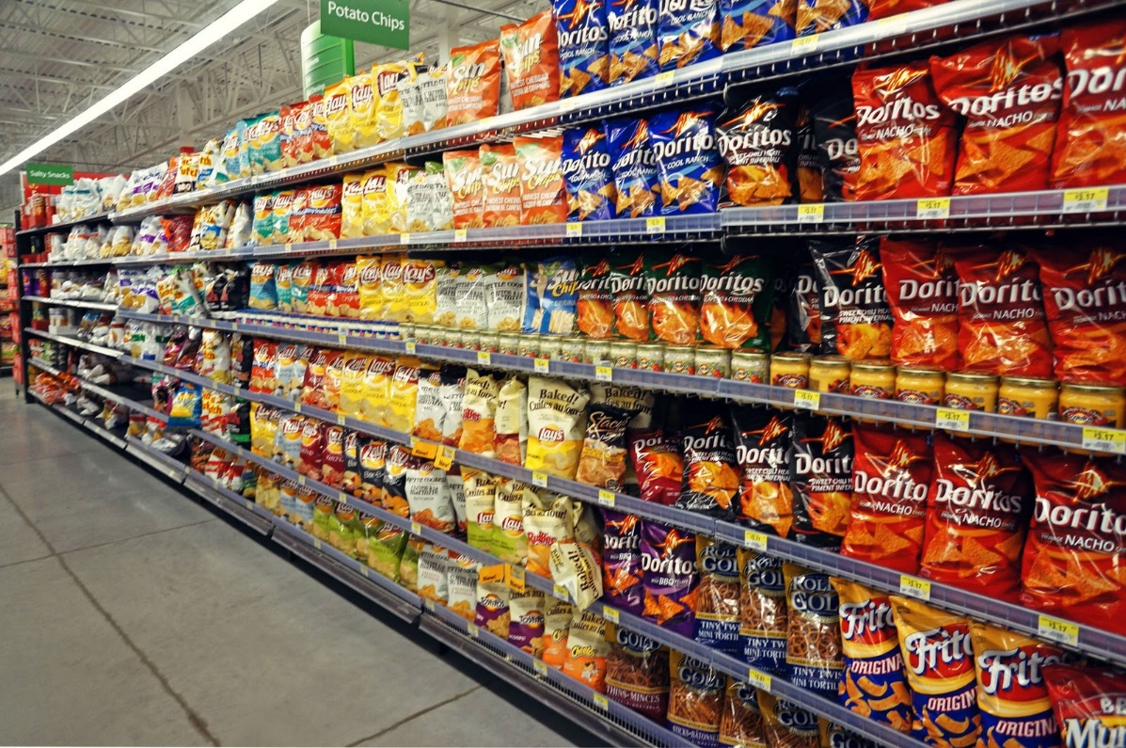
MKT 6337 Marketing Predictive Analytics Project
Salt Snacks
Group 9
Ayush Singal
Madurranjani
Rajesh Ragipalem
Siddharth Vasudevan
Yuvanesh Vedaraju

Slide 2
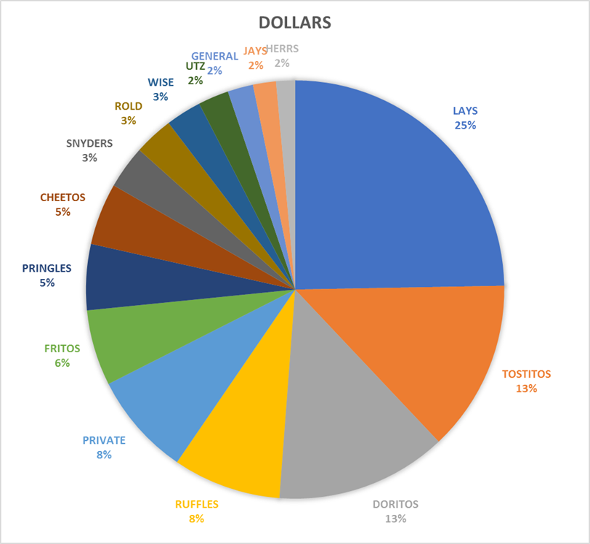
Market Share
Objective
To understand the data set using Descriptive Analysis
To compare preference of tops brands using MNL
To Identify best customer segment for particular brand using clustering

Slide 3
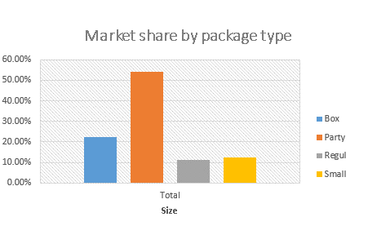
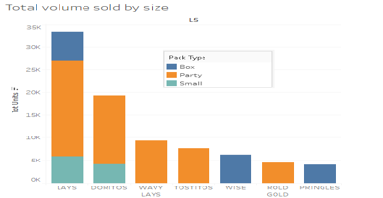
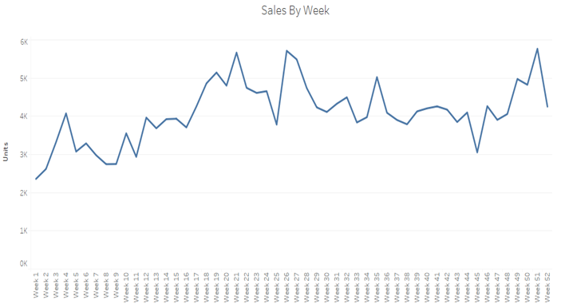
Descriptive Insights
Sales during July, October and December is high
Sales during February and September is low

Slide 4
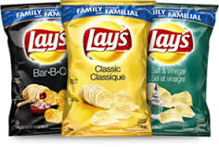

Brand Comparison using MNL
Age group of 11-55 males who are head of household
Male Laborers
Across all income group customers
College going males
Family size of 2- 5 people
Highly preferable brand

Slide 5
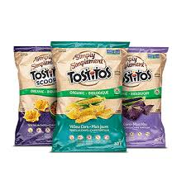
Brand Comparison using MNL
Preferred by household customers
High income group and low fat eating customers
Female Home makers
College graduated males

Slide 6
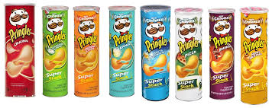
Brand Comparison using MNL
Preferred by teenagers
High income group customers
Low fat customers
Female Homemakers, Mid age
College going males

Slide 7
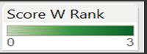
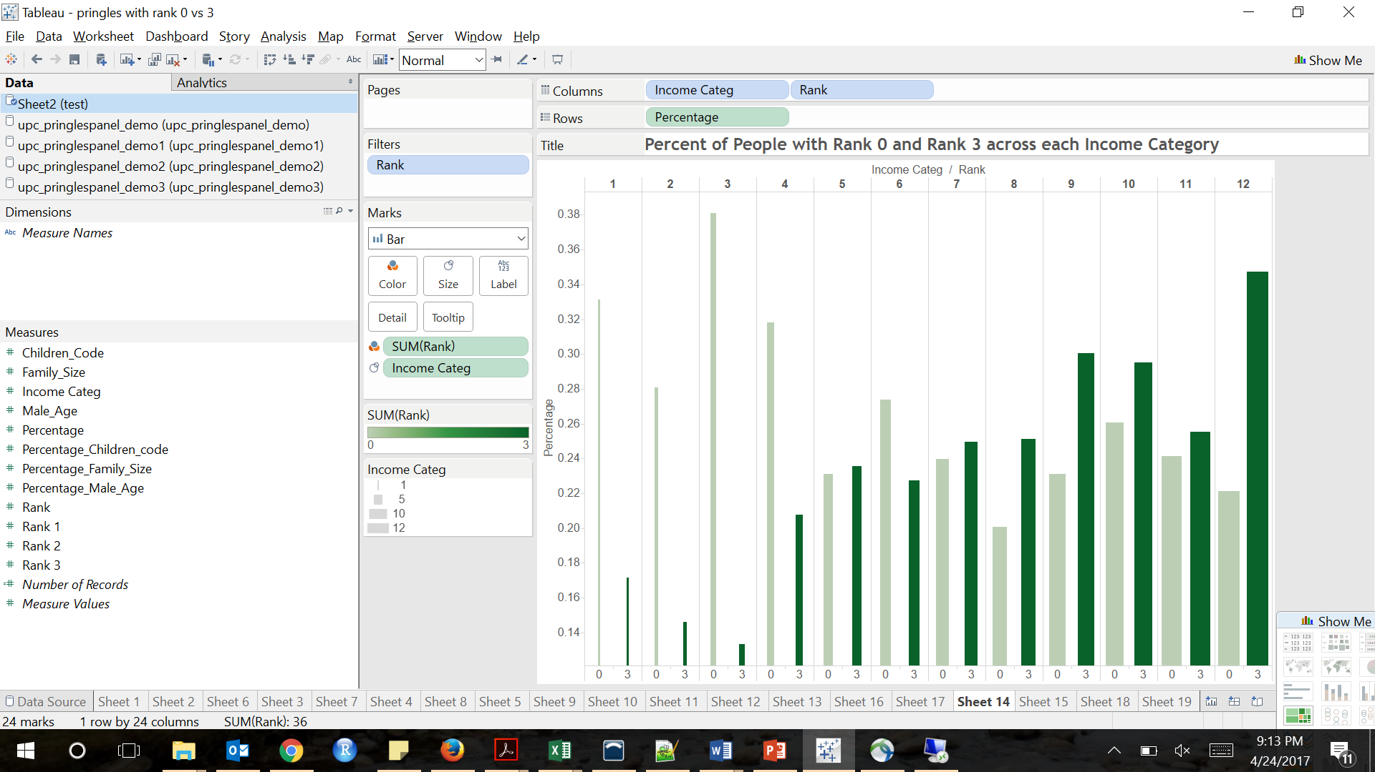
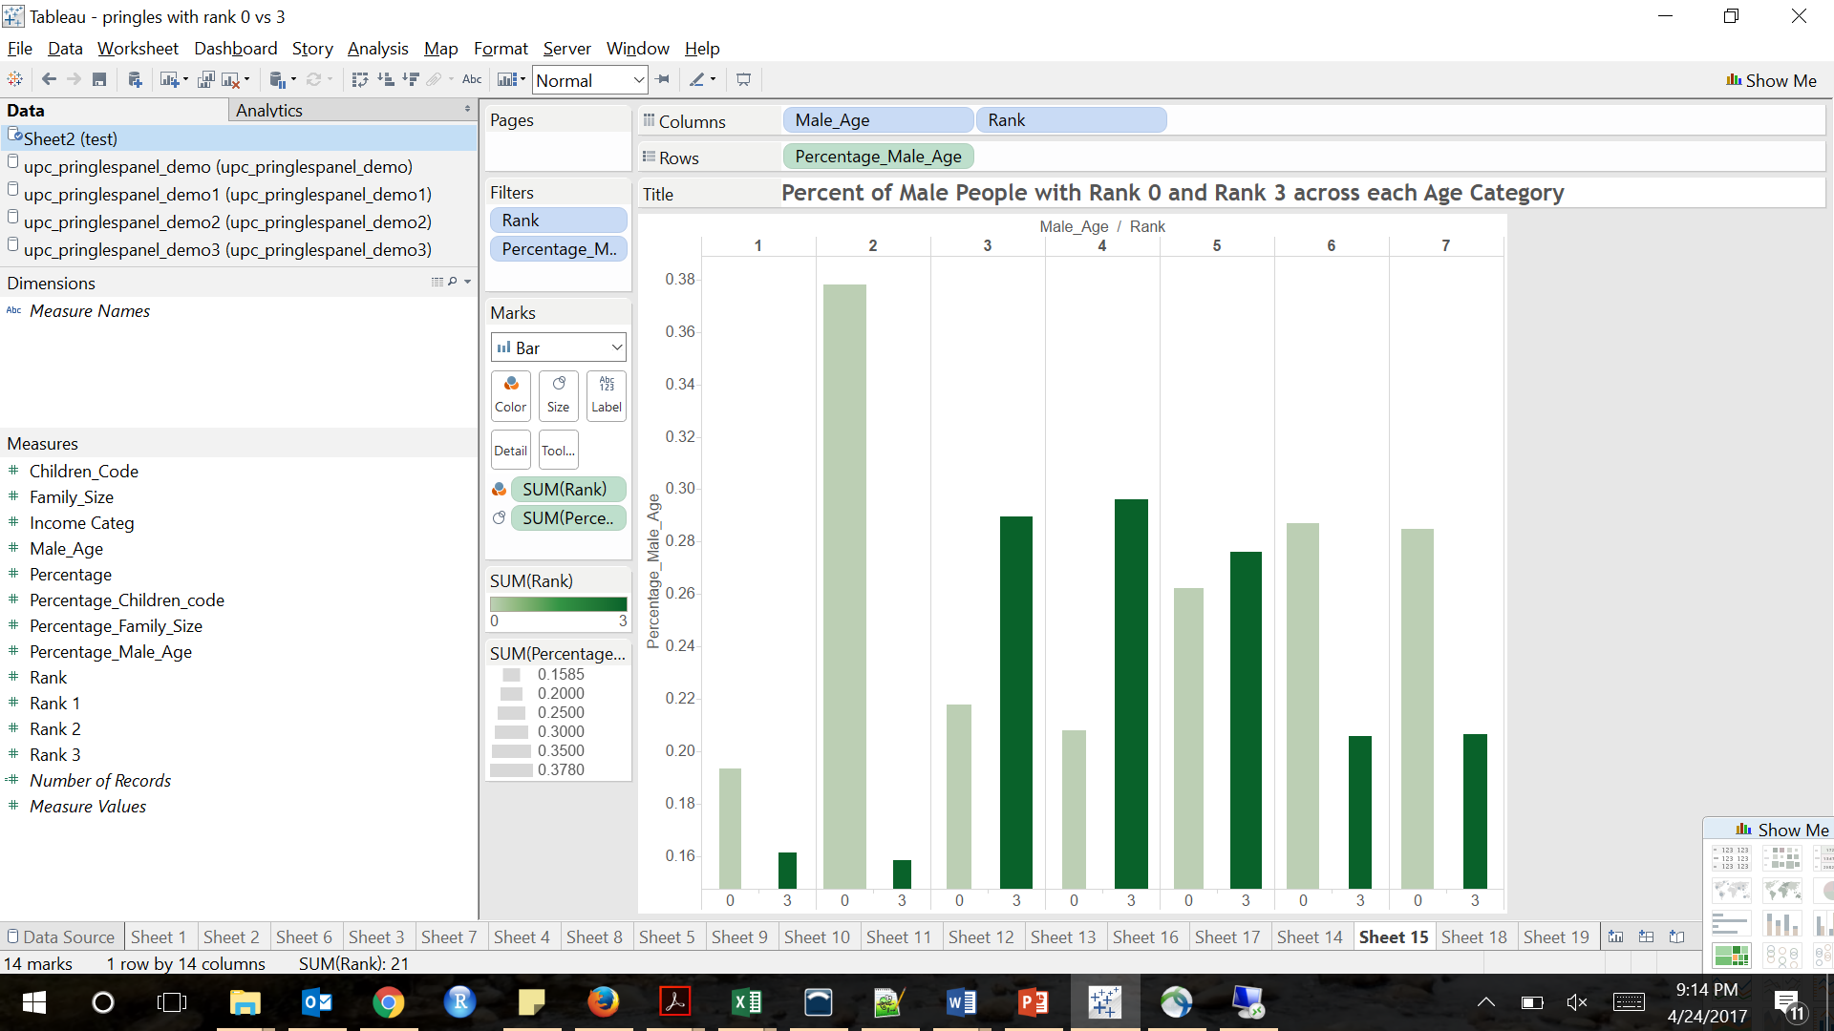
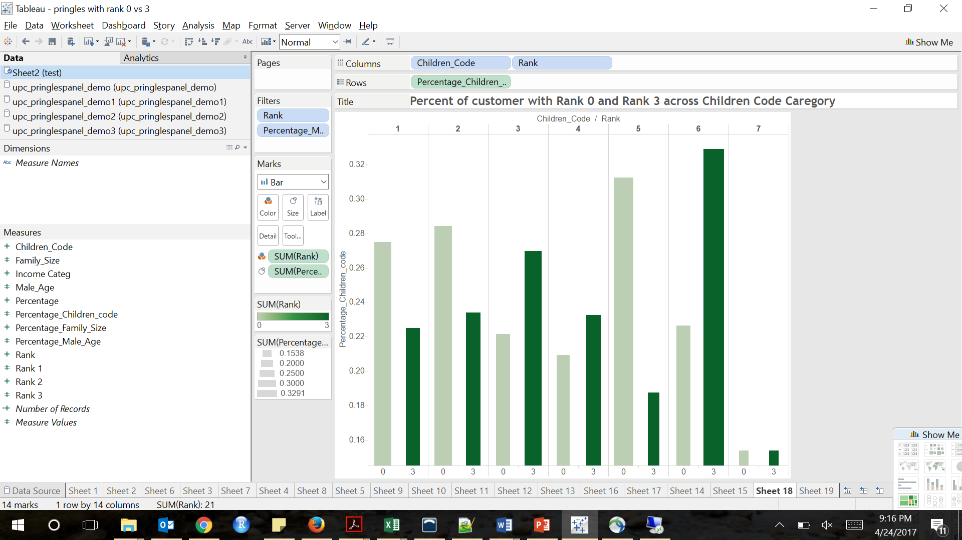
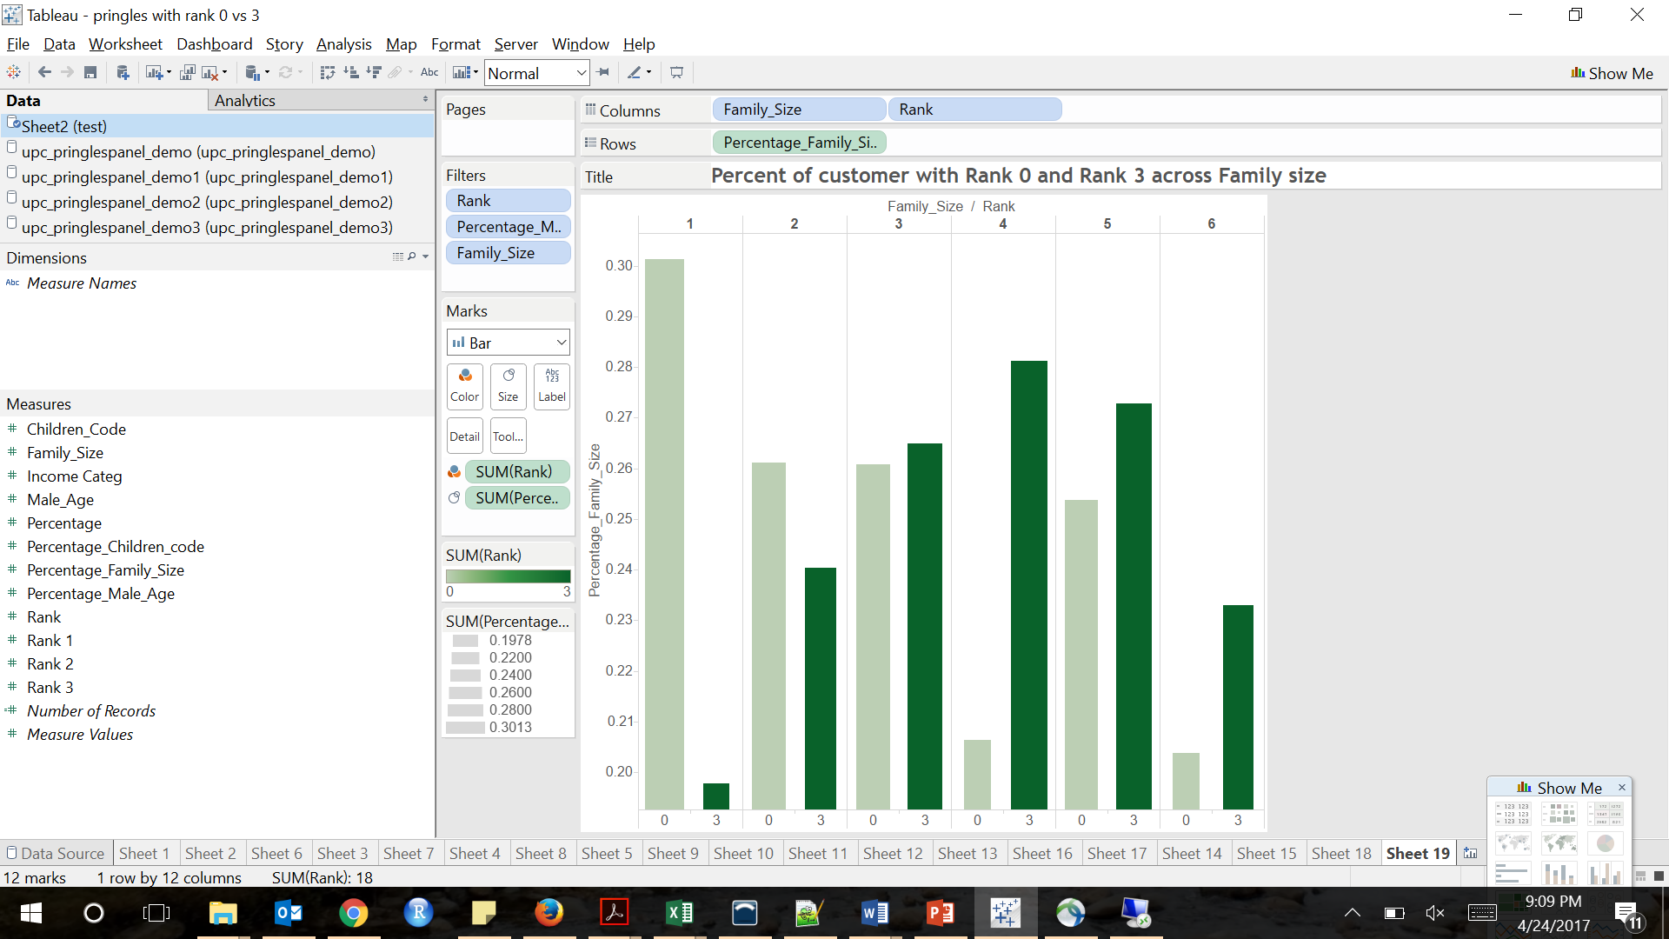
Clustering using RFM
Performed weighted RFM for brand “Pringles”
Comparison of Least and Most preferred customers (Rank0 and Rank3)
Income Group 7 to 12
Male Age Group 3 & 4
Children Group 3 & 6
Family size 4

Slide 8
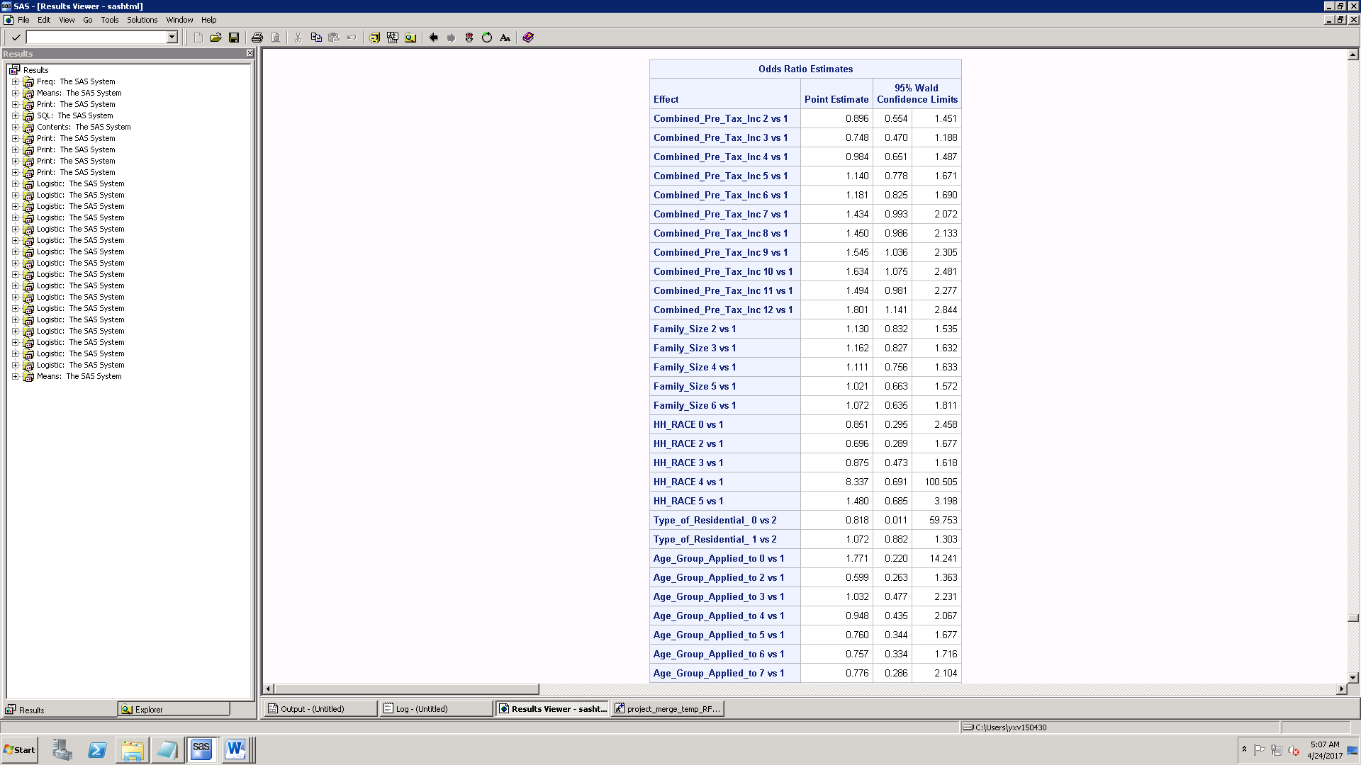
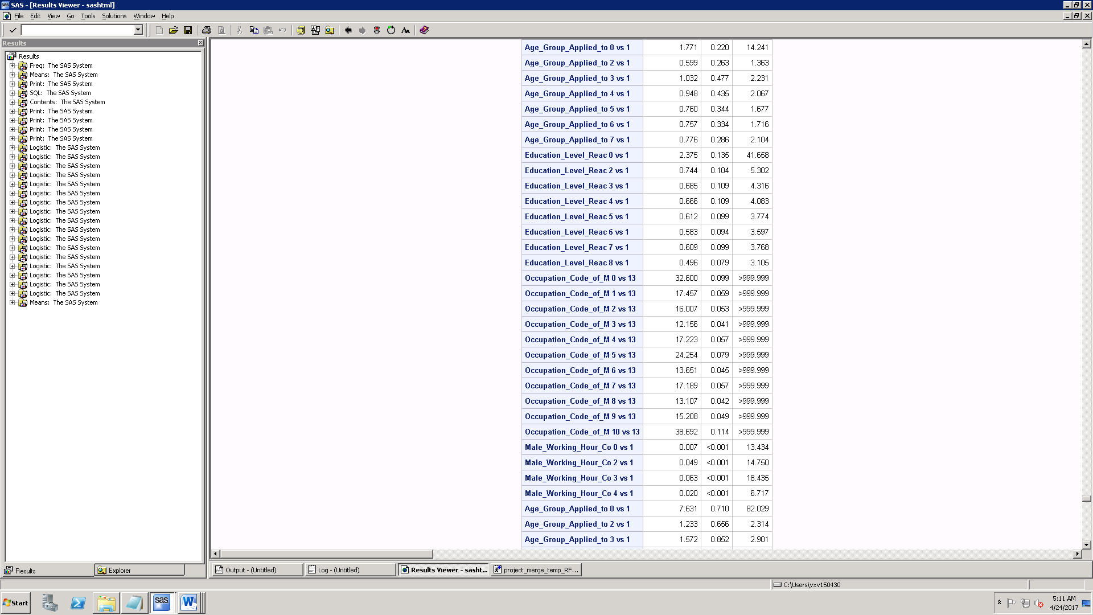
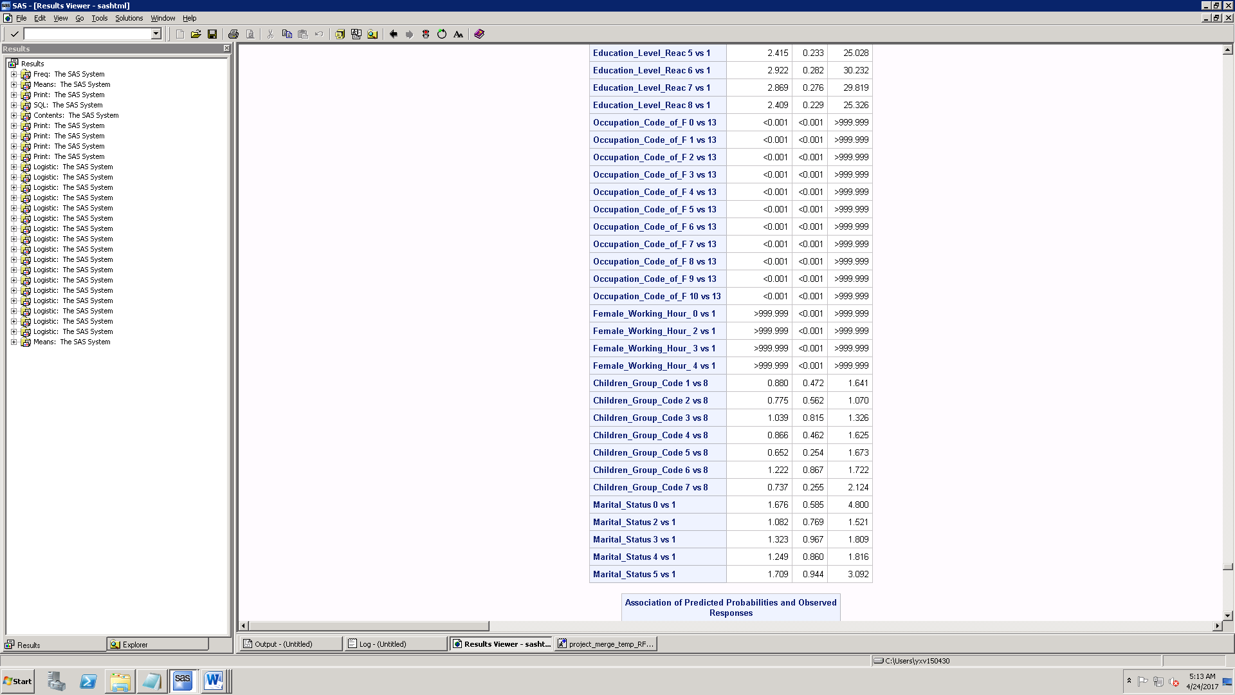
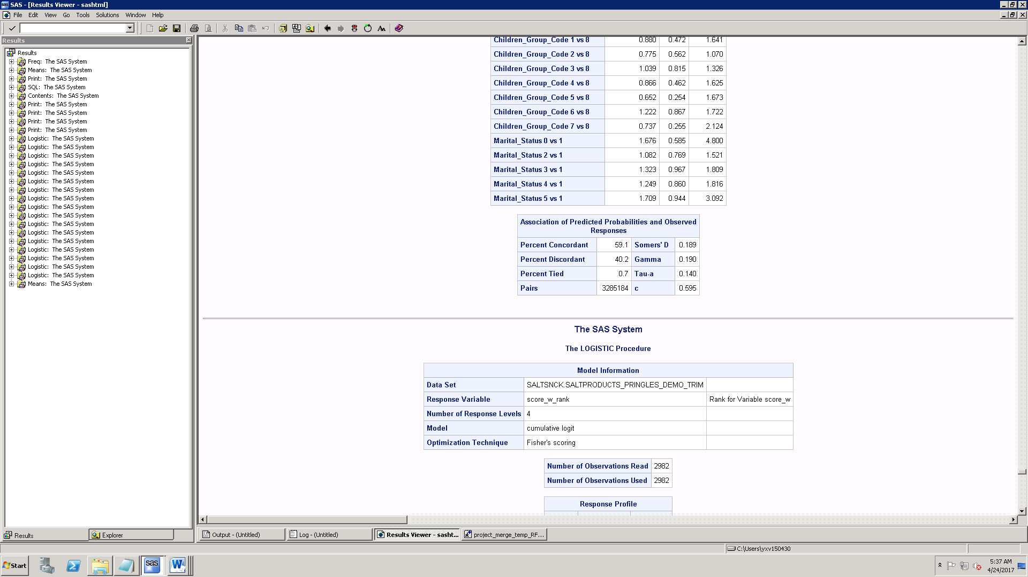
Profiling & Ordinal Logit
y as rank, x as demographics
Who are high ranked Customers ?
Income Category 7 to 12 (35,000$ to 100,000$)
Family Size 2 to 4
Male Age Group 3 (35 to 44 years old)
Children Code 3 & 6 (6-11 and 12-17 years old)
Interpretation:
When income category changes from 1 to 8, percentage
increase in odds of customer becoming high rank increases by 45%
When family size increase from 1 to 3, percentage increase in odds of
Customer becoming high rank increases by 16%

Slide 9
Recommendations for Pringles
Concentrate on Displays to attract high income health conscious
More Frequent purchaser programs on promoting healthy snacks
Increase more flavors, to attract more teenage customers

Slide 10


